Slide 1
VIDAR PHARMACEUTICAL ENTERPRISES

Slide 2
Company Profile
Business Name: Vidar Pharmaceutical Enterprises
President: Vic A. Corales
General Manager: Leila T. Corales
Area Supervisor: Viyan Corales
Company Pharmacist: Michelle Liwag
Line of Business DRUG TRADER/ WHOLESALER OF MEDICINE
Office Address: 655 Jose Coronado St., Nagcarlan, Laguna
Telephone No: (049) 5307095
Mobile No: 09228484687 / 09994100732

Slide 3
Registration Numbers
Business Permit No. 0012
Valid from January 2, 2014 to December 30, 2014
DTI Certificate No. 01821171
Valid from August 31, 2012 to August 31, 2017
FDA LTO No. RDII-RIV-DT-023
Valid from June 27, 2012 to March 17, 2014

Slide 4
Marti-Lian Pharma Link
Business Permit No. 1542
Valid from March 19, 2014 to December 30, 2014
DTI Certificate No. 01221688
Valid from Nov. 22, 2010 to November 22, 2015
FDA LTO No. RDI-RIV-DW-675
Valid from January 11, 2014 to January 11, 2016

Slide 5
Product Line

Slide 6
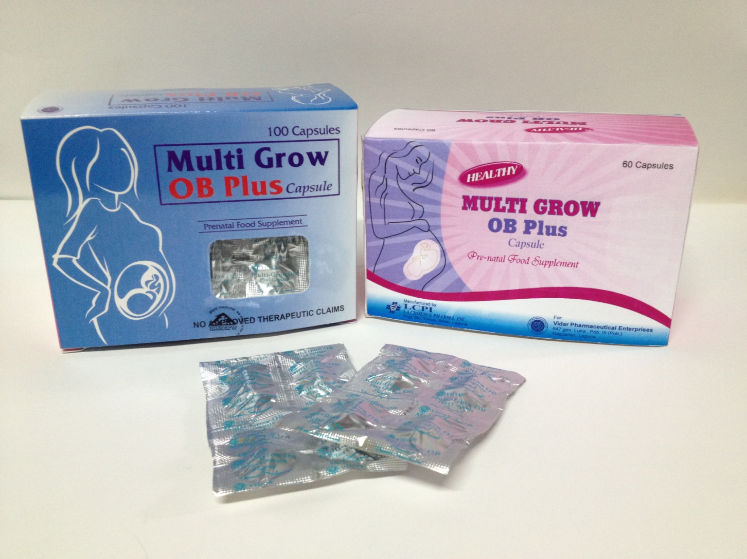
Multi Grow OB Plus Capsule

Slide 7
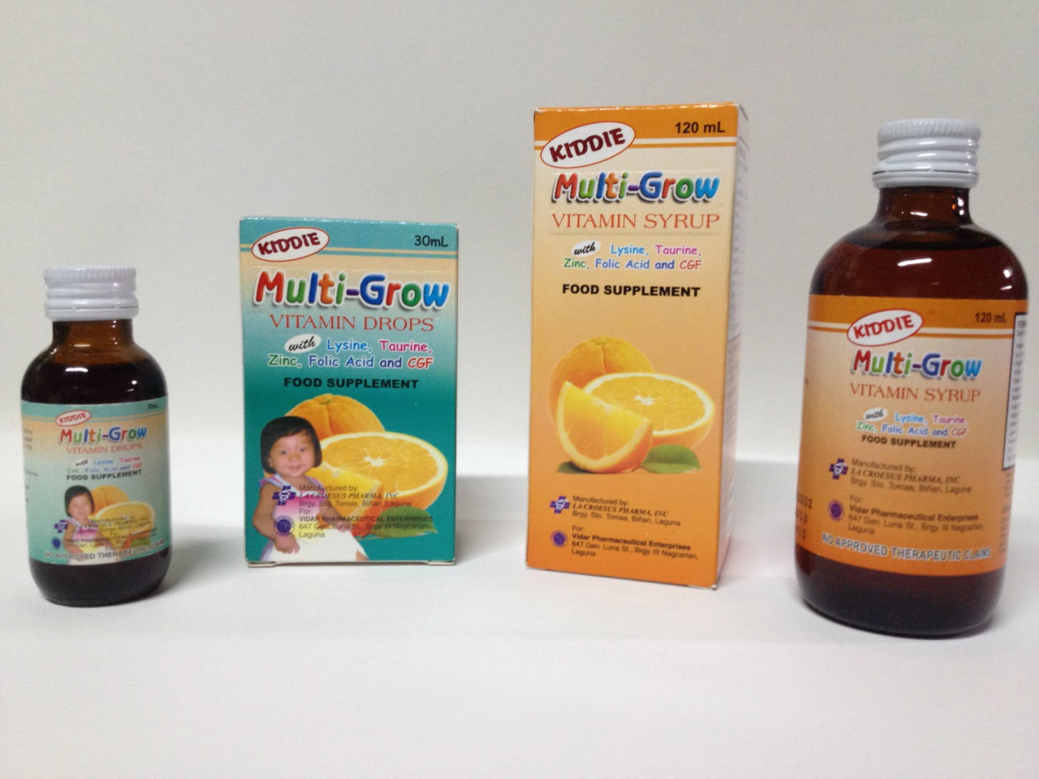
Multi-Grow Vitamin 120mL Syrup & 30mL Drops

Slide 8
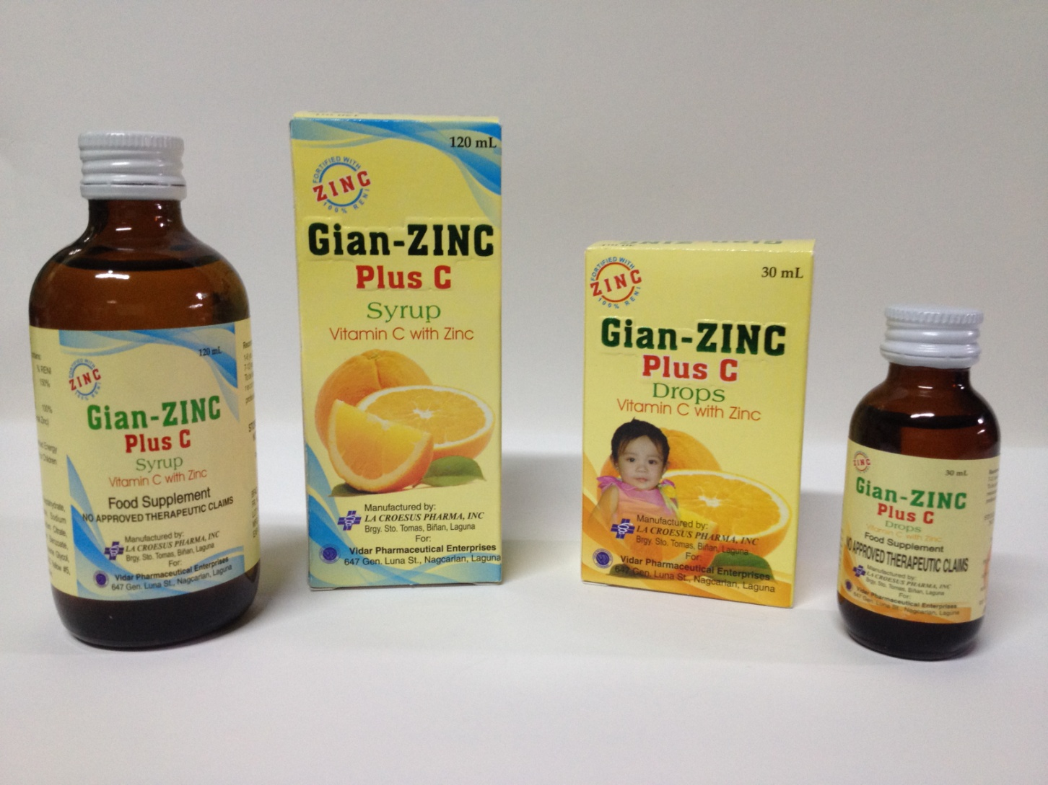
Gian-ZINC Plus C 120mL Syrup & 30mL Drops

Slide 9
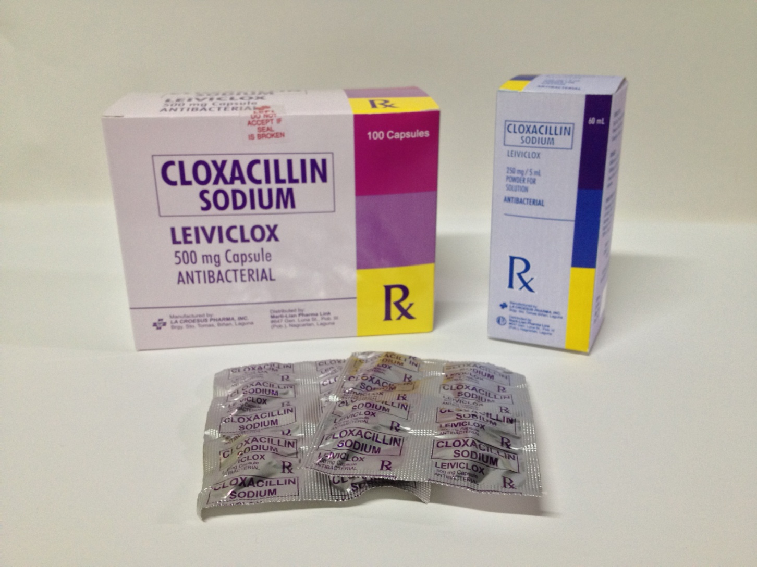
Leiviclox 500mg Capsule & 60mL Syrup Cloxacillin Sodium

Slide 10
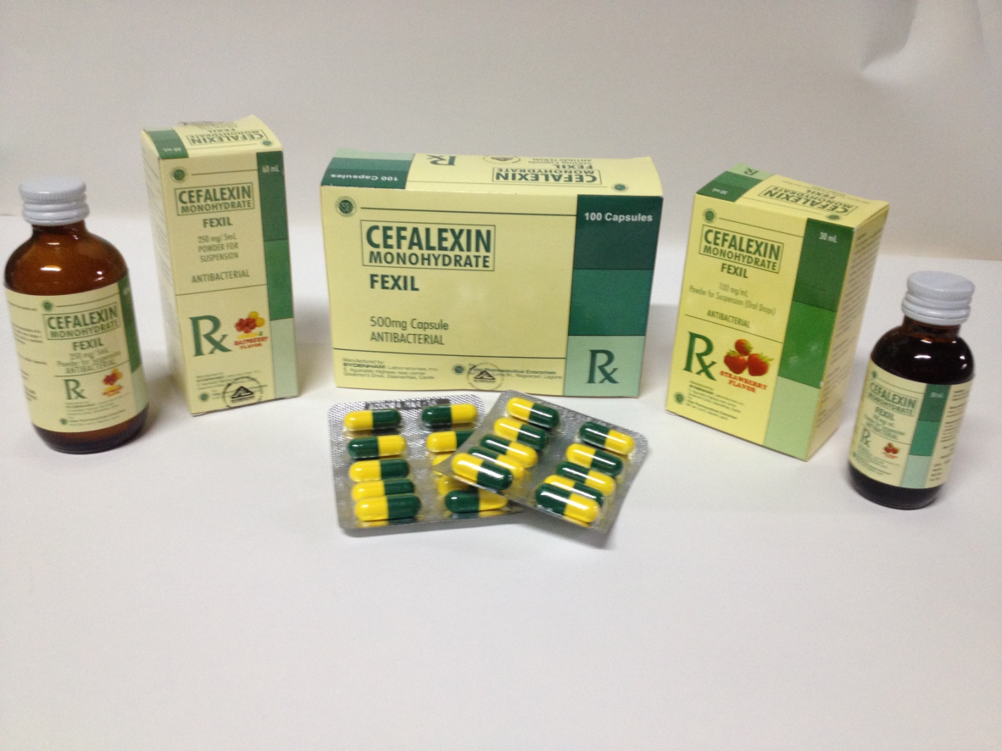
Fexil 500mg Cap,250mg 60mL Susp. & 100mg 30mL Drops

Slide 11
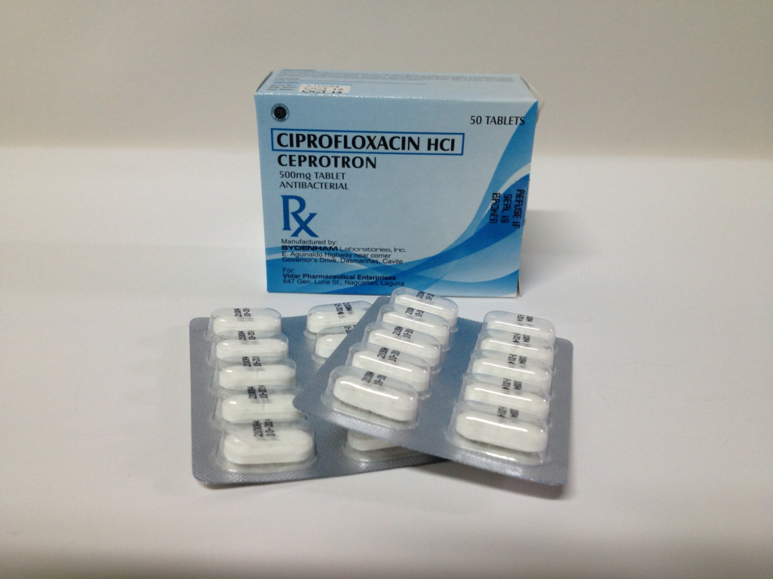
Ceprotron Ciprofloxacin HCI

Slide 12
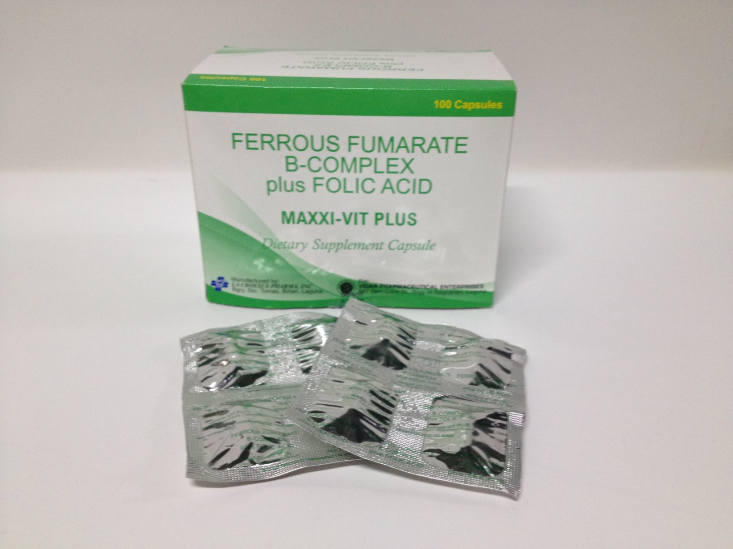
Maxxi-Vit Plus Capsule Ferrous Fumarate B-Complex plus Folic Acid

Slide 13
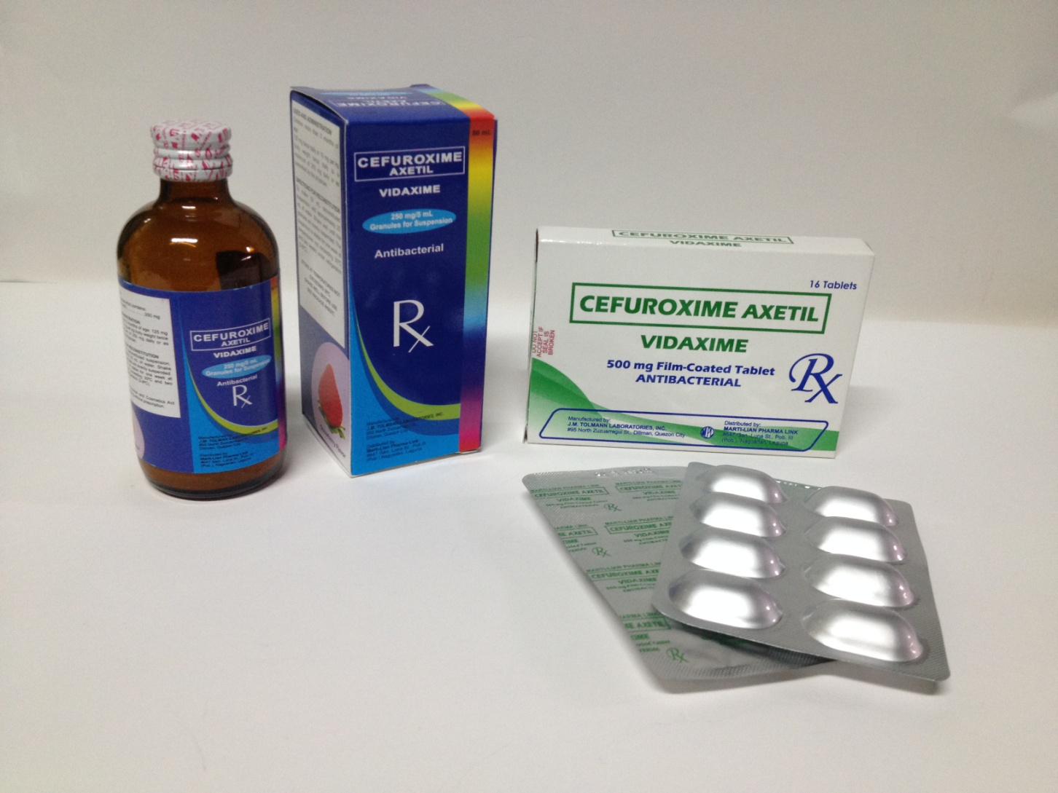
Vidaxime 500mg Cap. & 250mg 50mL Susp. Cefuroxime Axetil

Slide 14
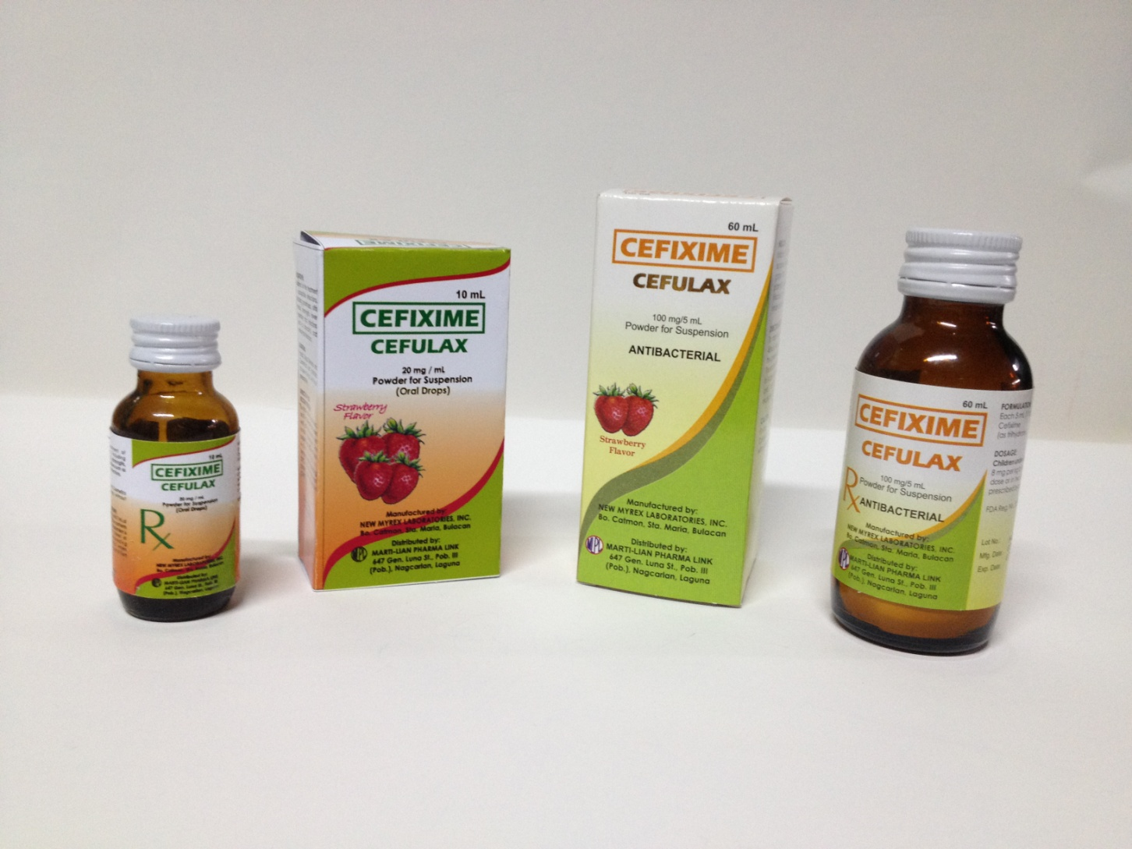
Cefulax 60mL (100mg/5 mL)Susp. & 10mL (20mg/mL) Drops Cefixime

Slide 15
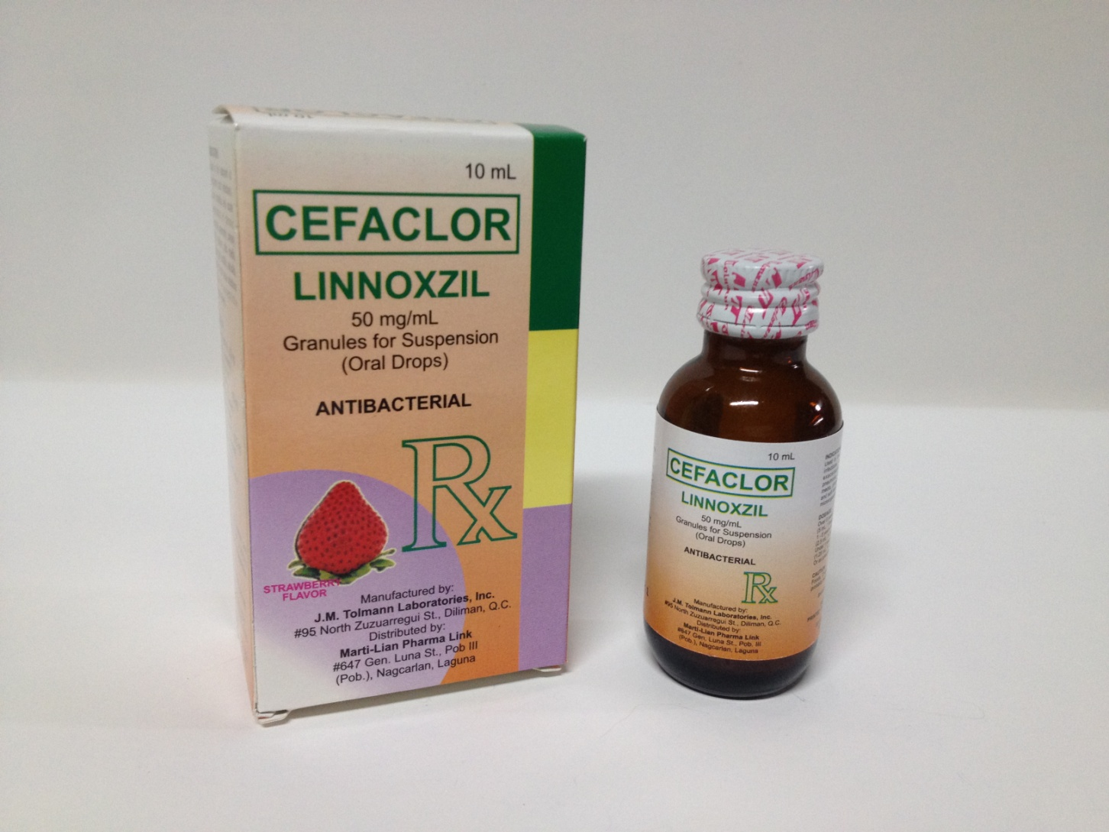
Linnoxzil 10mL (50mg/mL) Drops & 60mL (250mg) Susp. Cefaclor

Slide 16
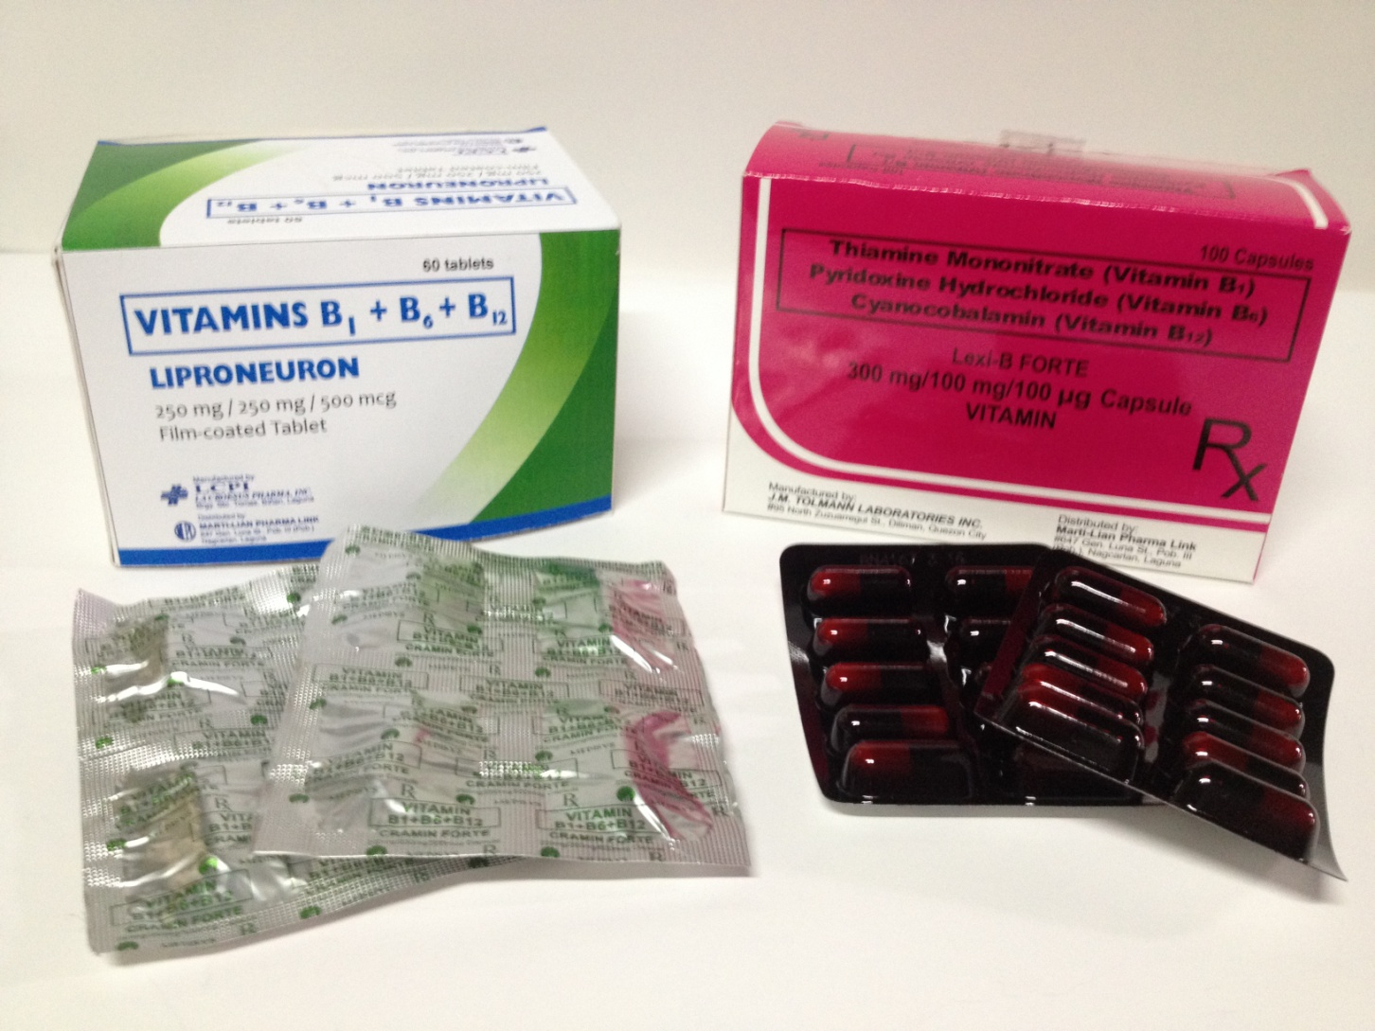
Leiproneuron Vit. B1+B6+B12 (250mg/250mg/500mg) Lexi-B Forte B1+B6+B12 (300mg/100mg/100mg)

Slide 17
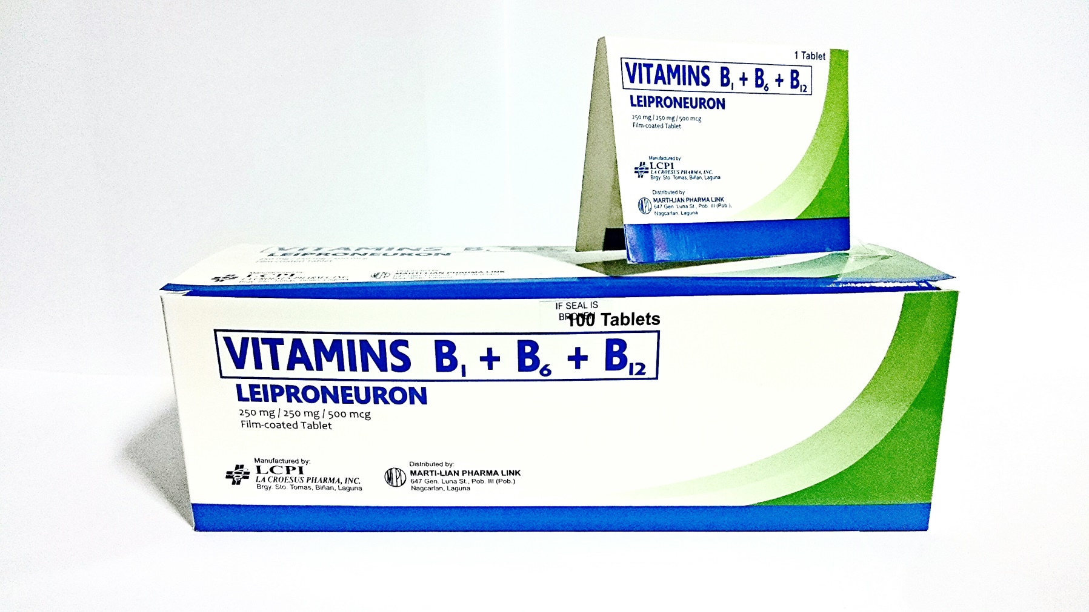
Leiproneuron Vit. B1+B6+B12 (250mg/250mg/500mg)

Slide 18
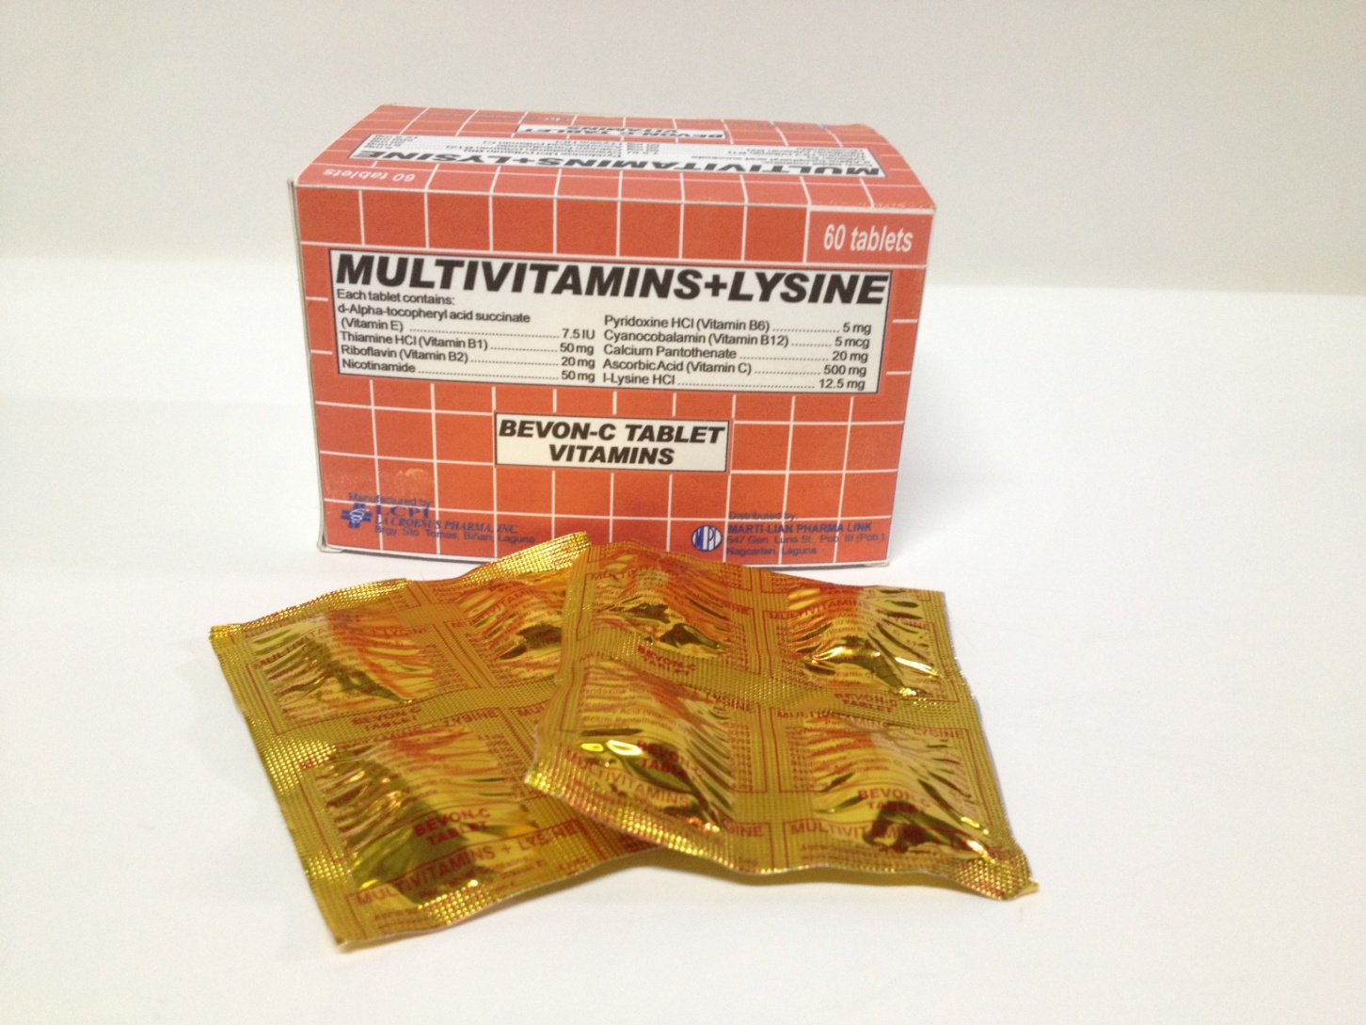
Bevon-C Tablet Vitamins, 60mL & 120mL Syrup
Multivitamins+Lysine
Each tablet contains:
Vitamin E 7.5 IU
Vitamin B1 50mg
Vitamin B2 20mg
Nicotinamide 50mg
Vitamin B6 5mg
Vitamin B12 5mcg
Calcium Pantothenate 20mg
Vitamin C 500mg
L-Lysine HCI 12.5mg

Slide 19
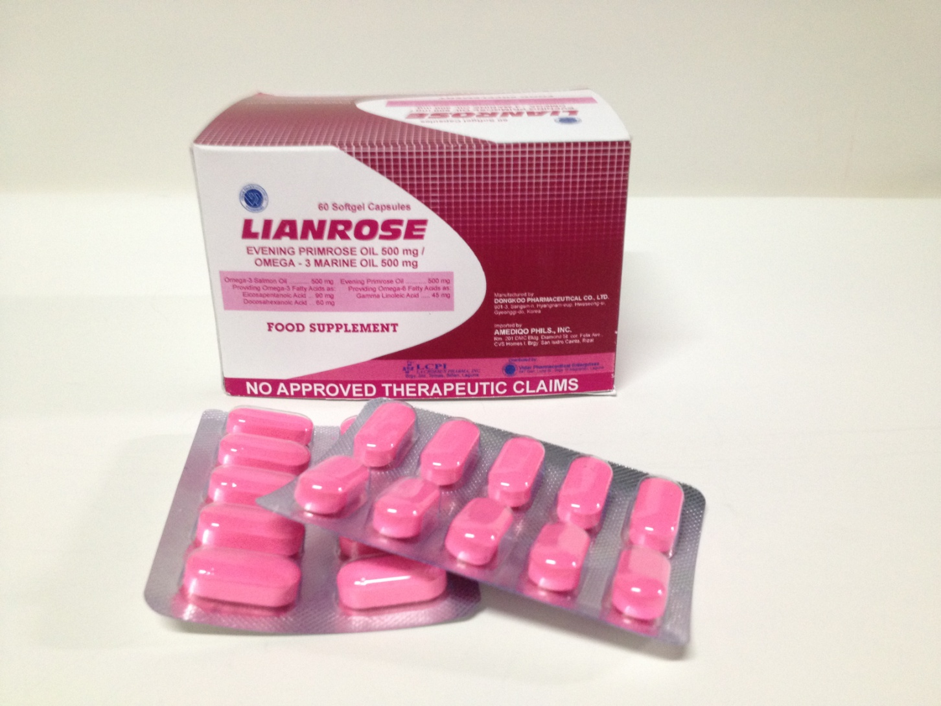
Lianrose Evening Primrose Oil 500mg/ Omega-3 Marine Oil 500mg

Slide 20
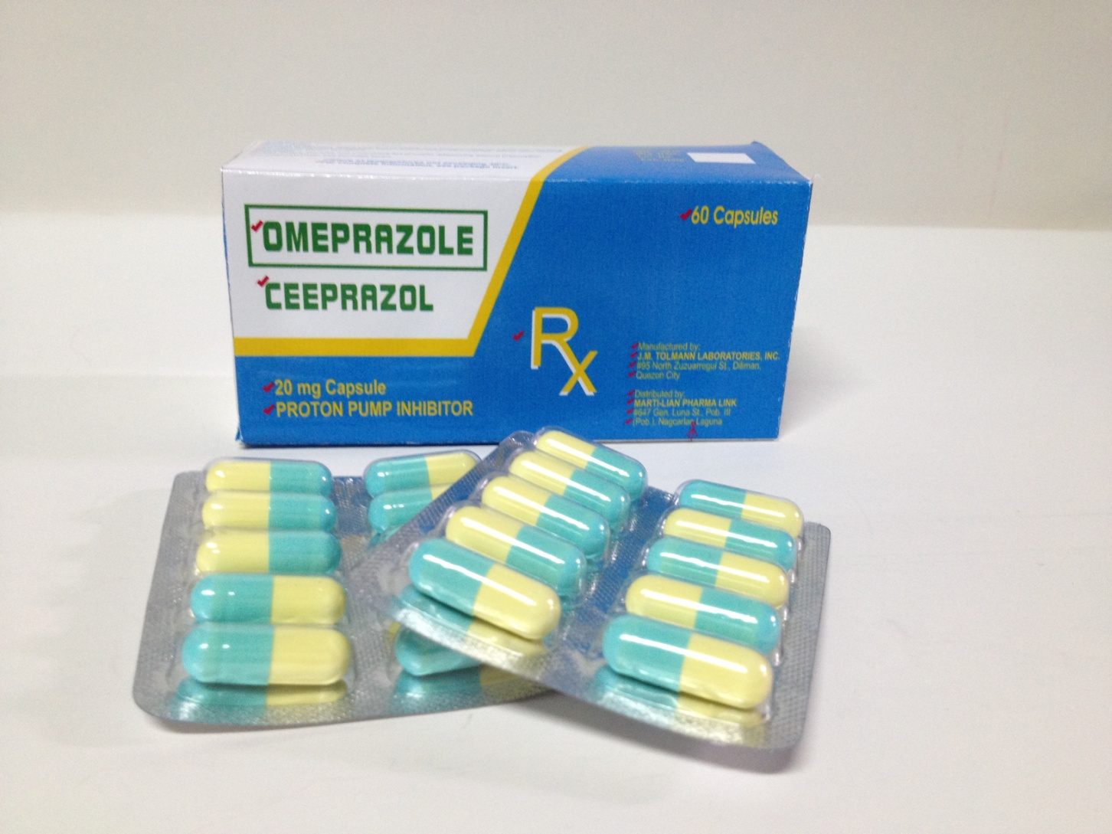
Ceeprazol Caps. 20mg Proton Pump Inhibitor

Slide 21
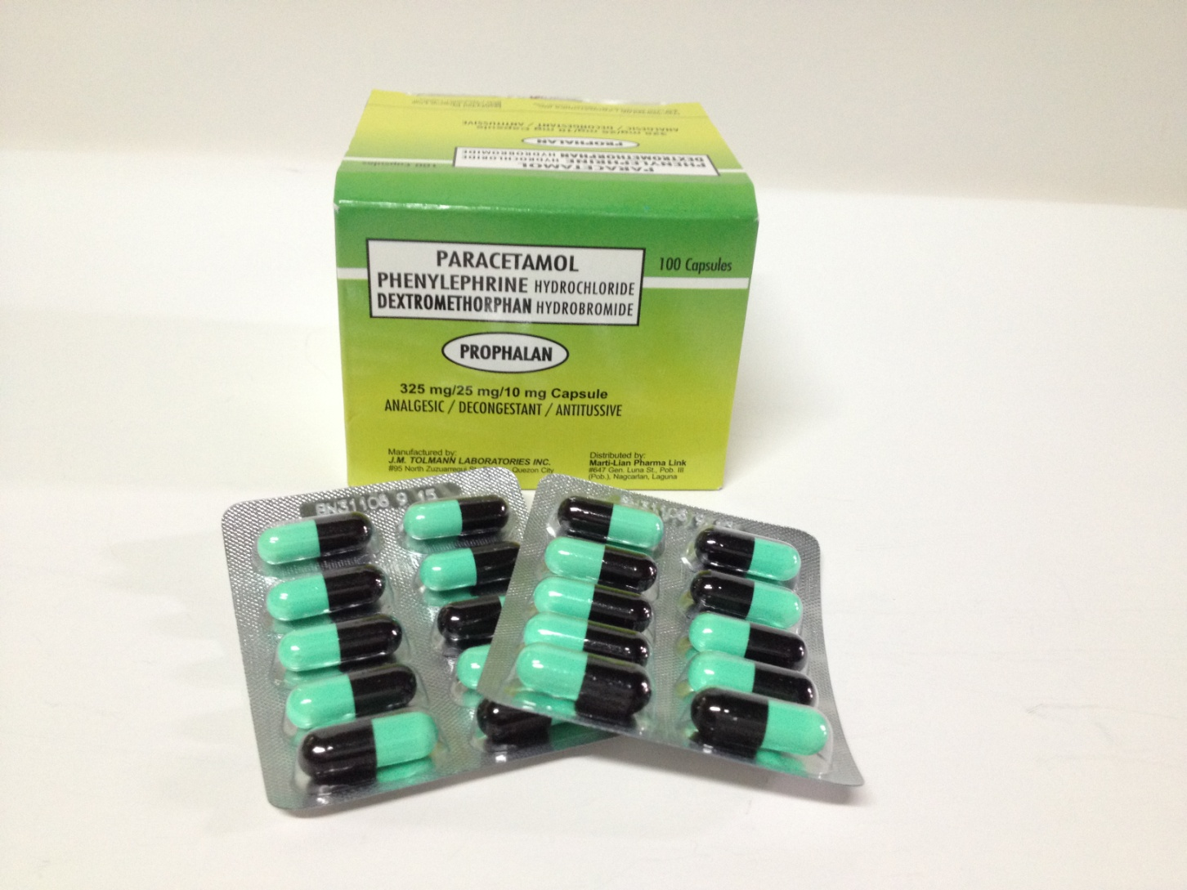
Prophalan Caps. Paracetamol Phenylephrine Dextromethorphan Analgesic/Decongestant/Antitussive 325mg/25mg/10mg Caps

Slide 22
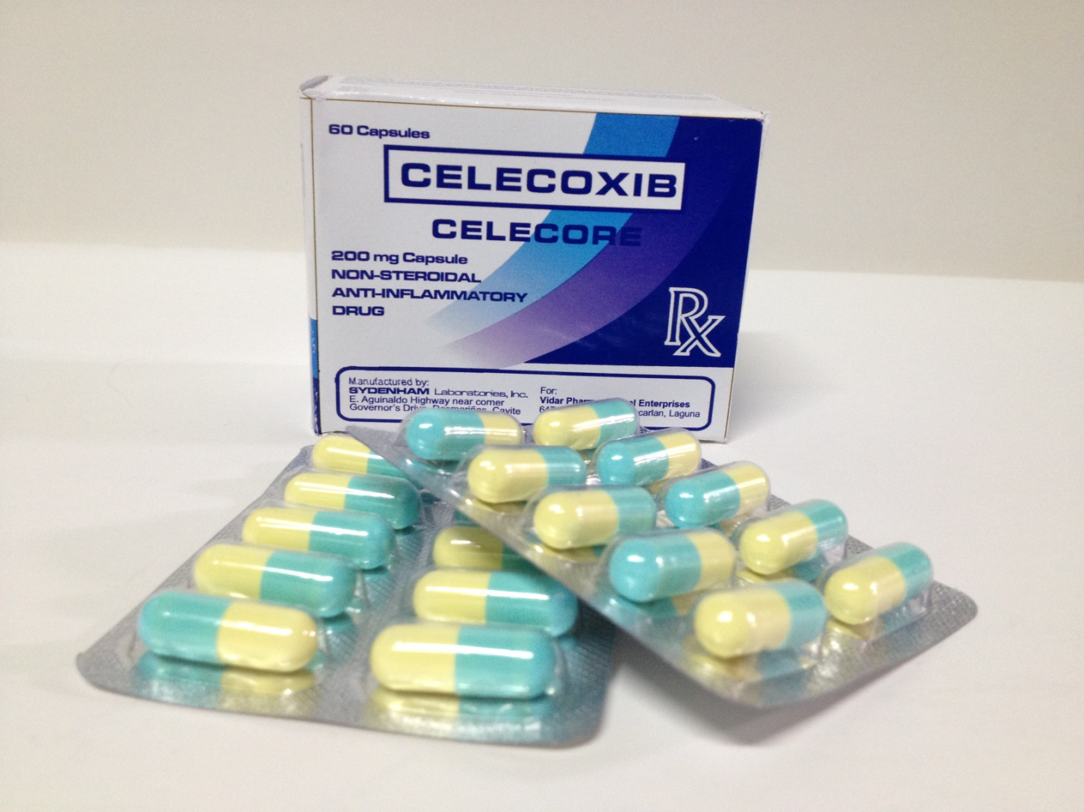
Celecore Caps. 200mg Non-Steroidal Anti-Inflammatory Drug

Slide 23
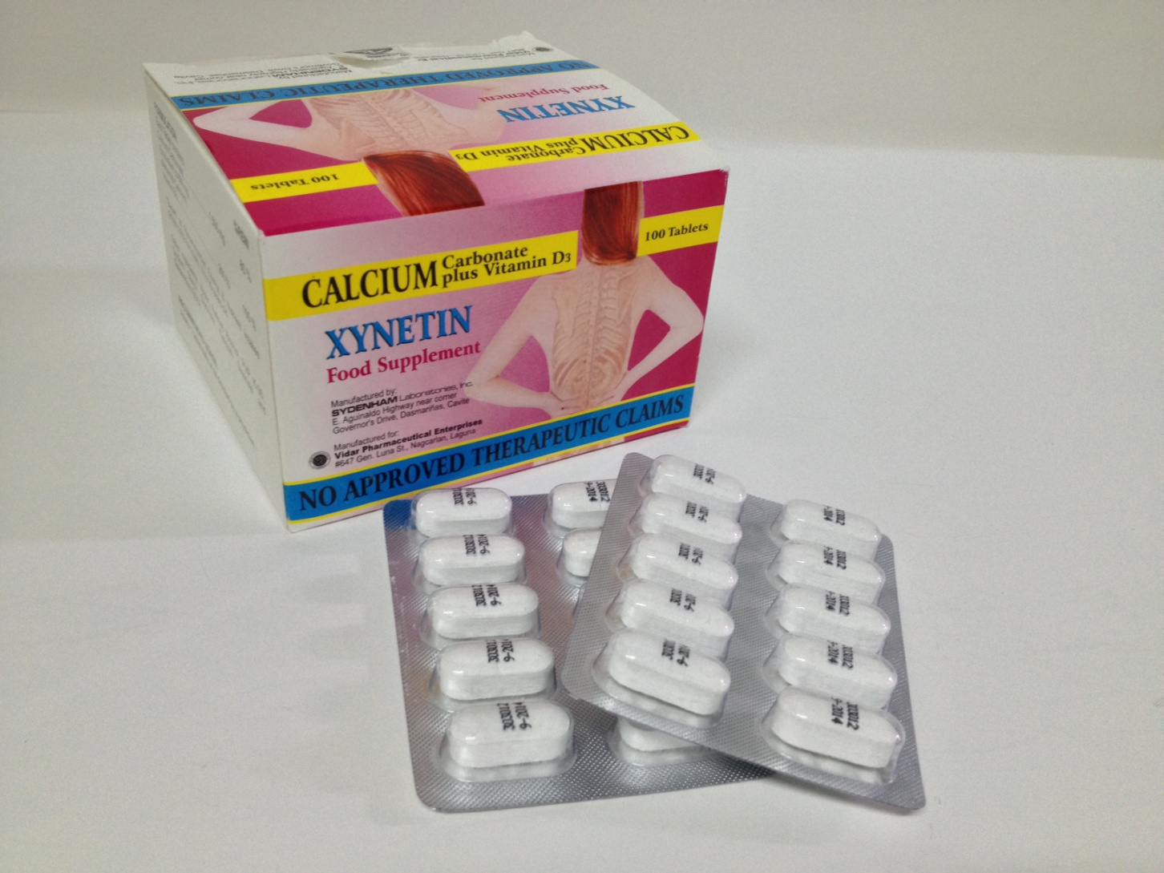
Xynetin Food Supplement Calcium Carbonate plus Vitamun D3

Slide 24
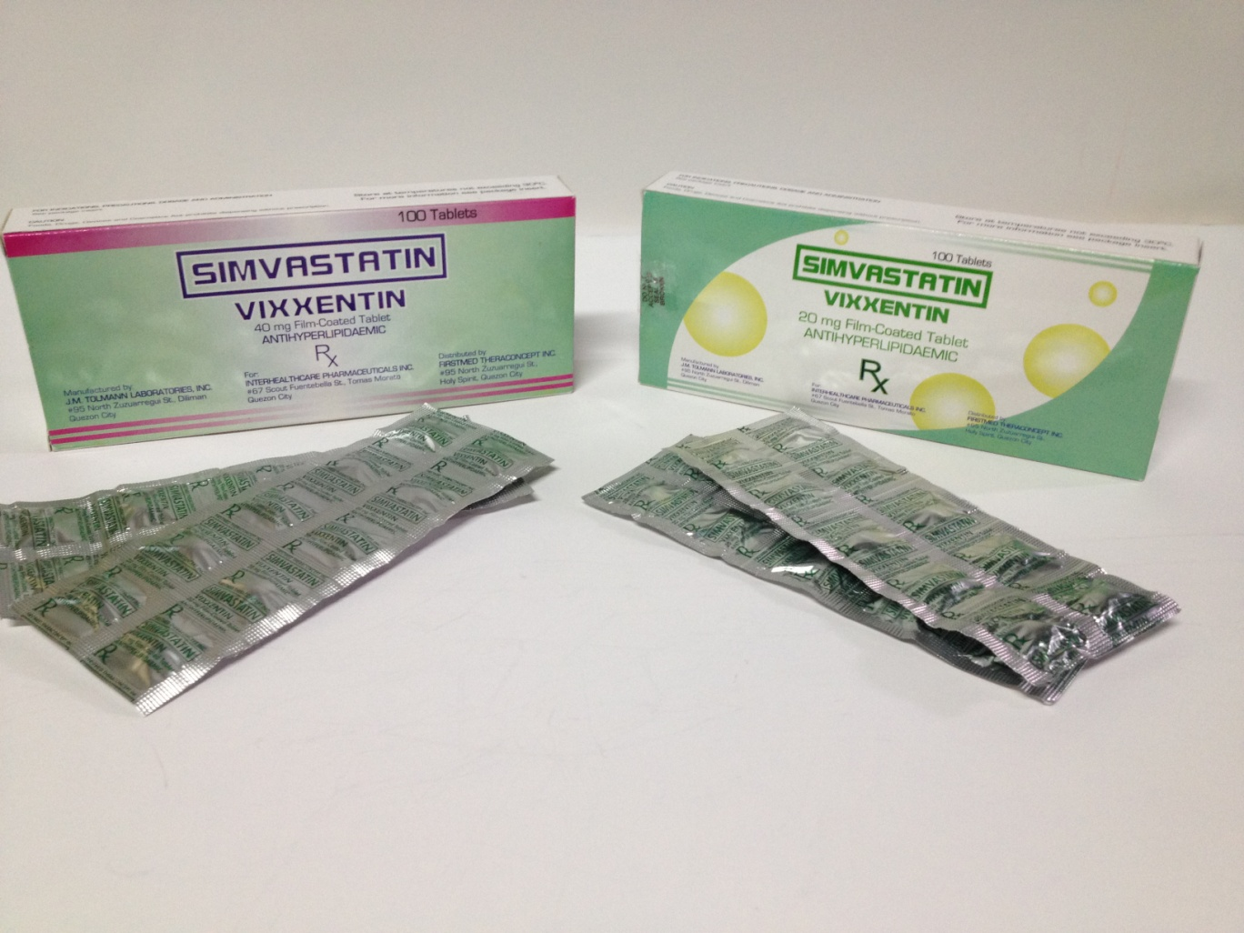
Vixxentin Simvastatin 40mg Antihyperlipidaemic 20mg Antihyperlipidaemic

Slide 25
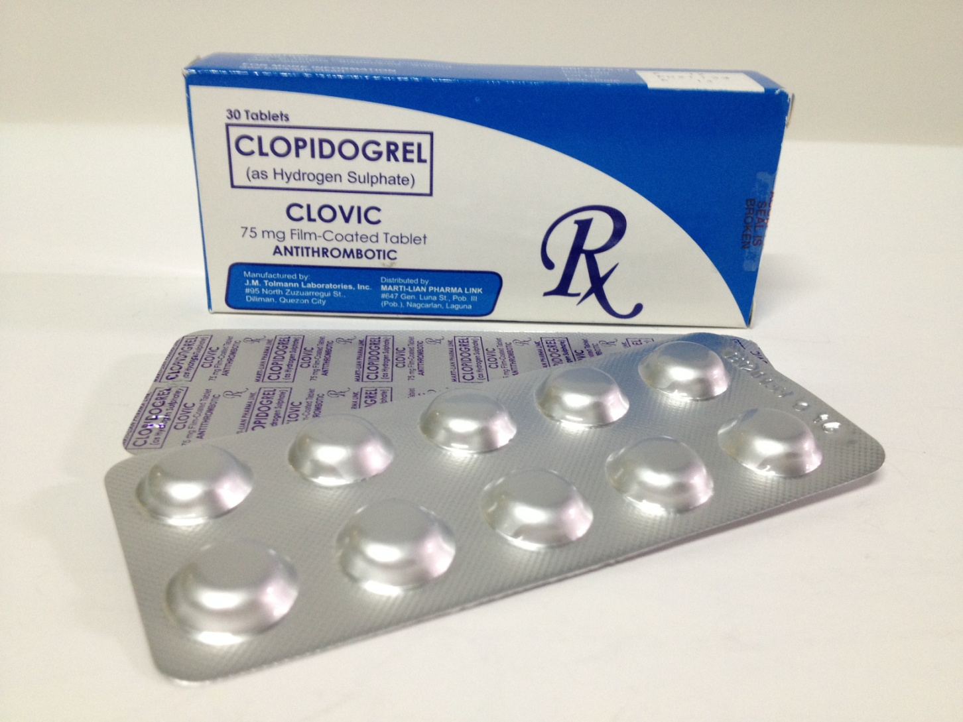
Clovic 75mg Tab. Antithrombotic

Slide 26
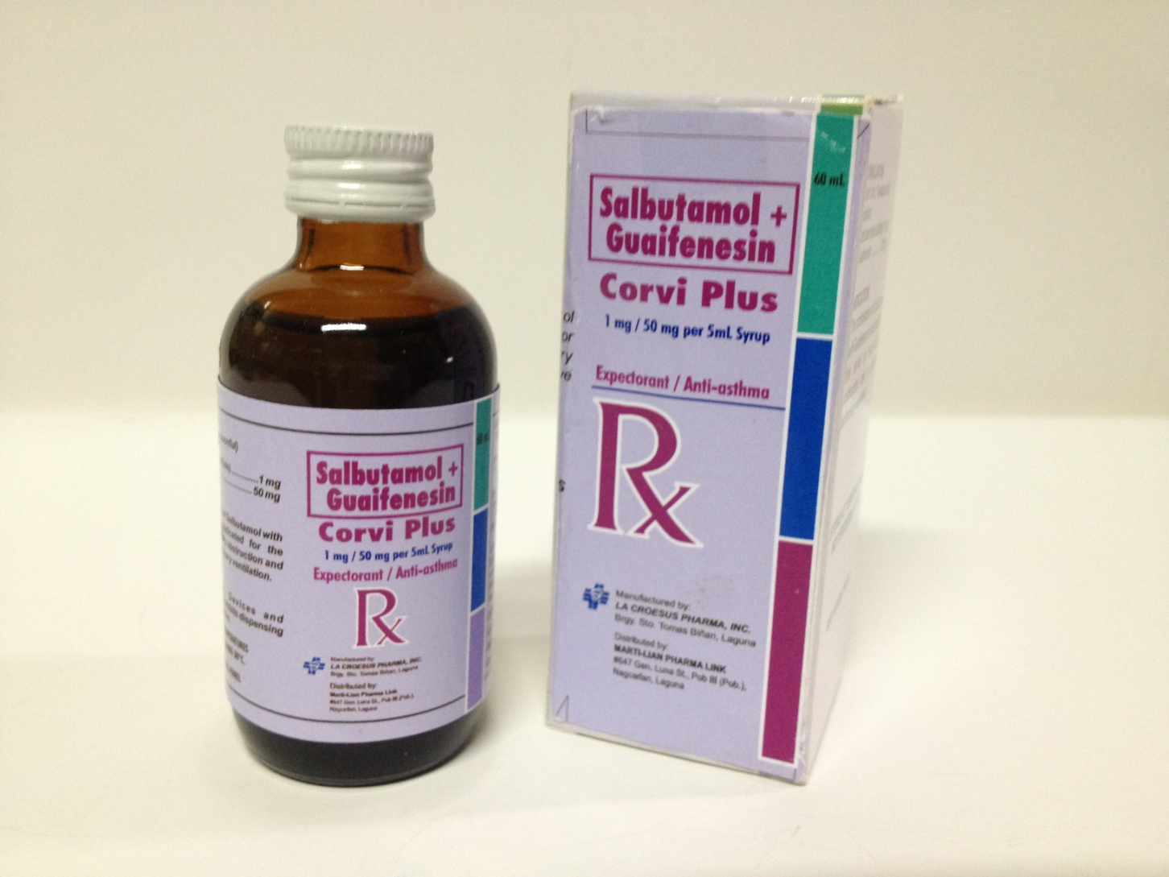
Corvi Plus 60mL Salbutamol + Guaifenesin 1mg/50mg per 5mL Syrup

Slide 27
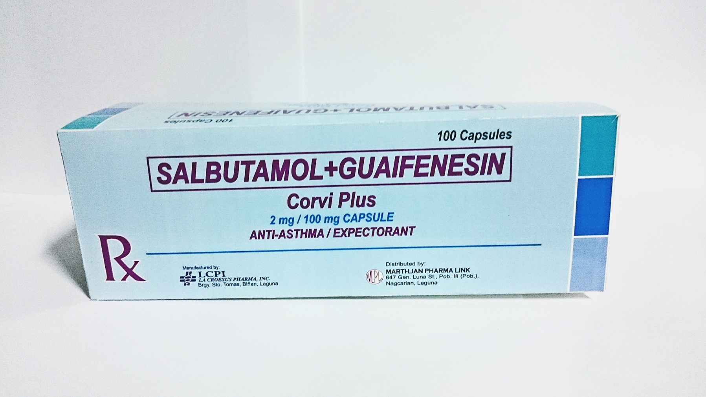
Corvi Plus Salbutamol + Guaifenesin 2mg/100mg Capsule

Slide 28
Incoming Products in 2014

Slide 29
Healthy Multi Grow OB Plus
Bevon-C
Ceeprazol (Omeprazole 20mg)
Celecore (Celecoxib 20mg)
Leiviclox (Cloxacillin 250mg Susp.)
Cefulax Drops (Cefixime Drops)
Lianrose (Evening Primrose Oil 500mg/ Omega-3 Marine Oil 500mg)
Linnoxil Susp. (Cefaclor 250mg Susp.)

Slide 30
End of Presentation

